Slide 1

Covid-19 Proteins Analysis
By
Heba Allah. Hashim
Manar Mahmoud
Mohamed Nasser
Mohamed Waleed

Slide 2
About the project
Compare sequences of covid_19 proteins.
Clarification the function of Every protein, and determine proteins with similar function.
Visualisation the results of similar sequences using boxplot and scatterplot.

Slide 3
SARS‑CoV‑2
- SARS‑CoV‑2 is a virus of the species (severe acute respiratory syndrome–related coronavirus (SARS-CoV) ).
- It is believed to have zoonotic origins and has close genetic similarity to bat coronaviruses, suggesting it emerged from a bat-borne virus. Research is ongoing as to whether SARS‑CoV‑2 came directly from bats or indirectly through any intermediate hosts.

Slide 4
The SARS-CoV-2 virus can infect a wide
range of cells and systems of the body.
- COVID‑19 is most known for affecting the respiratory tract:
The lungs are the organs most affected by COVID‑19 because The virus uses a special surface glycoprotein called a "spike" to connect to the ACE2 receptor and enter the host cell.
- Nervous system:
virus has been detected in cerebrospinal fluid of autopsies, the exact mechanism by which it invades the CNS remains unclear and may first involve invasion of peripheral nerves given the low levels of ACE2 in the brain.
- The virus may also enter the bloodstream:
from the lungs and cross the blood-brain barrier to gain access to the CNS, possibly within an infected white blood cell.
- Gastrointestinal:
The virus affects gastrointestinal organs as ACE2 is abundantly expressed in the glandular cells of gastric, duodenal and rectal epithelium as well as endothelial cells and enterocytes of the small intestine.
- Cardiovascular system:
acute myocardial injuries may also be related to ACE2 receptors in the heart. ACE2 receptors are highly expressed in the heart and are involved in heart function.

Slide 5
ACE2 Enzyme
- The level of ACE2 in each tissue correlates with the degree of disease in that tissue
-Children have lower ACE2 receptor sites, so their chances of contracting covid19 are lower but the elderly have more ACE2 receptor sites, which is why they are highly affected by this virus.

Slide 6
SARS‑CoV‑2 Syndrome:
-It causes an often severe illness and is marked initially by systemic symptoms of (muscle, pain, headache, fever)
- followed in 2–14 days by the onset of respiratory symptoms, mainly cough, dyspnea, and pneumonia. Another common finding in SARS patients is a decrease in the number of lymphocytes circulating in the blood.

Slide 7
SARS-COV-2 Structural Proteins
Structural proteins are essential in many steps of the infection, they are implied in
viral genome production and Replication virion-receptor attachment
viron and viroporin formation that will promote virus entry into the host
proliferation and spread of the infection.

Slide 8
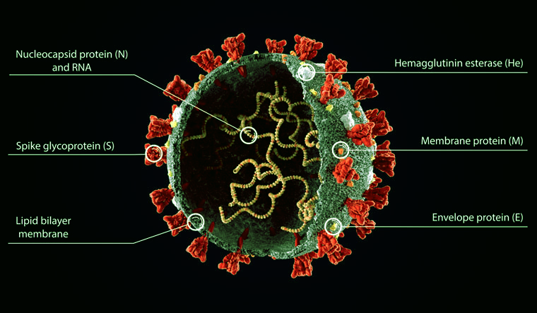
Holds the RNA genome.
Hemagglutinin esterase (HEs) is a glycoprotein that certain enveloped viruses possess and use as invading mechanism. HEs helps in the attachment and destruction of certain sialic acid receptors that are found on the host cell surface.
Responsible for allowing the virus to attach to and fuse with the membrane of a host cell
The S, E, and M proteins together create the viral envelope.
It is a tiny integral membrane protein that polymerizes to form ionic pore across the membrane called viroporins. It is essential for viral assembly and release
NOte:
A viral envelope is the outermost layer of many types of viruses. It protects the genetic material in their life cycle when traveling between host cells. Not all viruses have envelopes.
SARS-CoV-2 has four structural proteins

Slide 9
SARS-COV-2 Structural Proteins
The spike proteins (S) on the surface of the virus is a key factor involved in infection.
S Proteins are cleaved into :-
S1 subunits:- contains the receptor-binding domain (RBD) and directly binds to the peptidase domain (PD) of ACE 2 to gain entry into host cells. Peptidase activity of ACE2 is critical for the virion to gain access into the host cytosol.
S2 subunits :- harbors the functional elements required for membrane fusion of the virion.

Slide 10
SARS-COV-2 Non-Structural Proteins and peptides
In addition to the four structural proteins, the SARS-CoV2 genome encodes 16 non-structural proteins (NSPs) essential for virus replication but also to elicit the immune response and represent targets to develop future prophylactic and therapeutic approaches against COVID-19.

Slide 11
Function of nonstructural proteins of SARS-CoV-2
Nsp1: It inhibits host translation, causes invasion from host immune response and leads to efficient viral gene expression in infected cells.
Nsp2: It is entirely unknown.
Nsp3: It releases nsp1 and nsp2 from polyprotein, interacts with other viral nsps as well as RNA to form replication/transcription complex
Nsp4: Nsp3, 4, and 6 are predicted to function to nucleate and anchor viral replication complexes on double-membrane vesicles in the cytoplasm
Nsp5: automatically cleaved from polyproteins to produce mature enzyme, which then cleaves downstream nsps at 11 sites to release nsp4-nsp16
Nsp7: dimerizes and interacts with other proteins such as nsp5, nsp8, nsp9, and nsp13.
Nsp8: Nsp8 enzyme is able of initiate replication and has been proposed to operate as primase.

Slide 12
Function of nonstructural proteins of SARS-CoV-2
Nsp9: Plays a role in inhibiting the host innate immune response.
Nsp10: No function.
Nsp12: Nsp12, in association with nsp7, nsp8, and other essential components of the RNA synthesis machinery, forms a viral replication complex.
Nsp13: It unwinds dsRNA or DNA with a 5′→3′ polarity.
Nsp14: has a proofreading role, which prevents lethal mutagenesis.
Nsp15: This is thought to be an important way for the virus to hide from antiviral defense.
Nsp16: May play a role in host modulation..

Slide 13
Project
Implementation

Slide 14
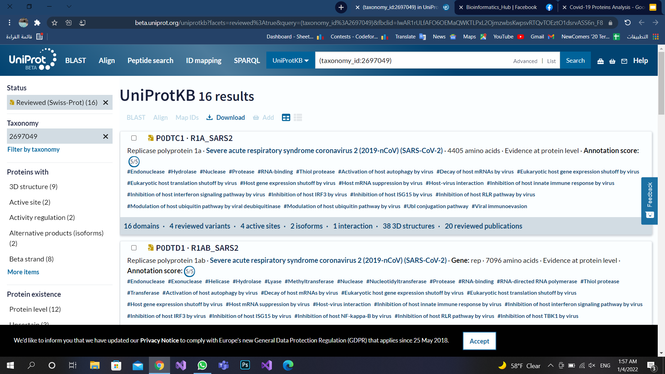
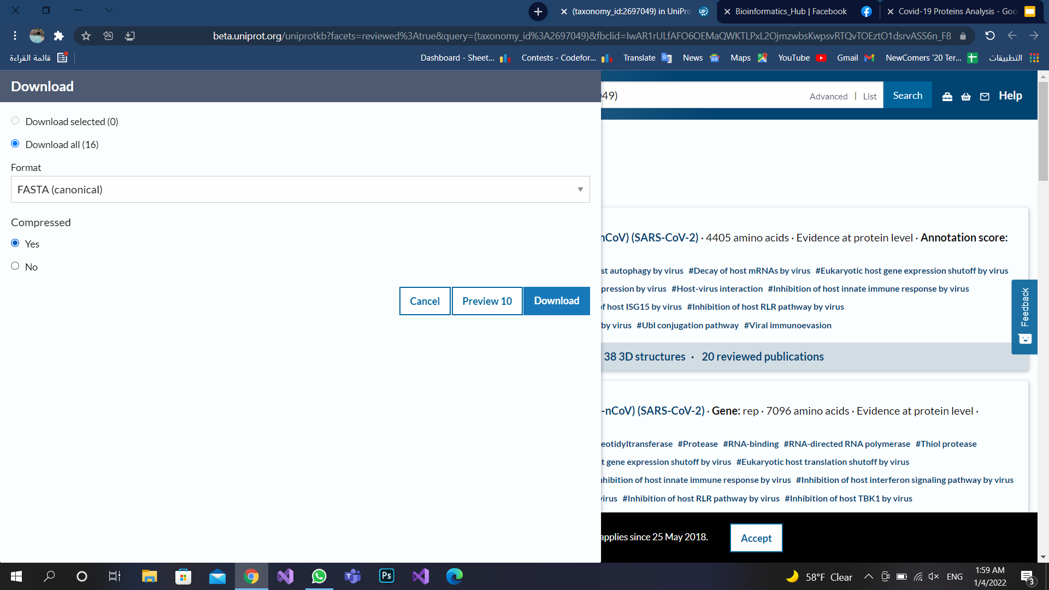
Get Data from Uniprot
(taxonomy_id:2697049)

Slide 15
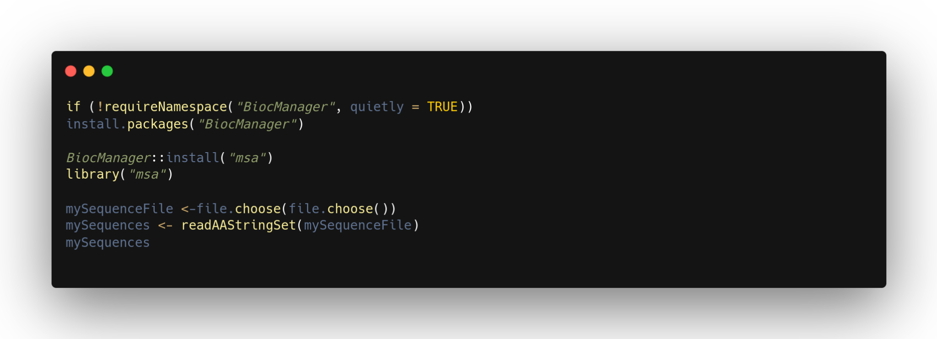
Read Proteins in fasta format

Slide 16
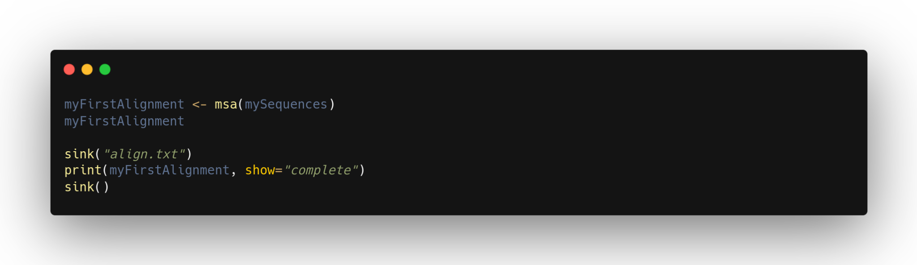
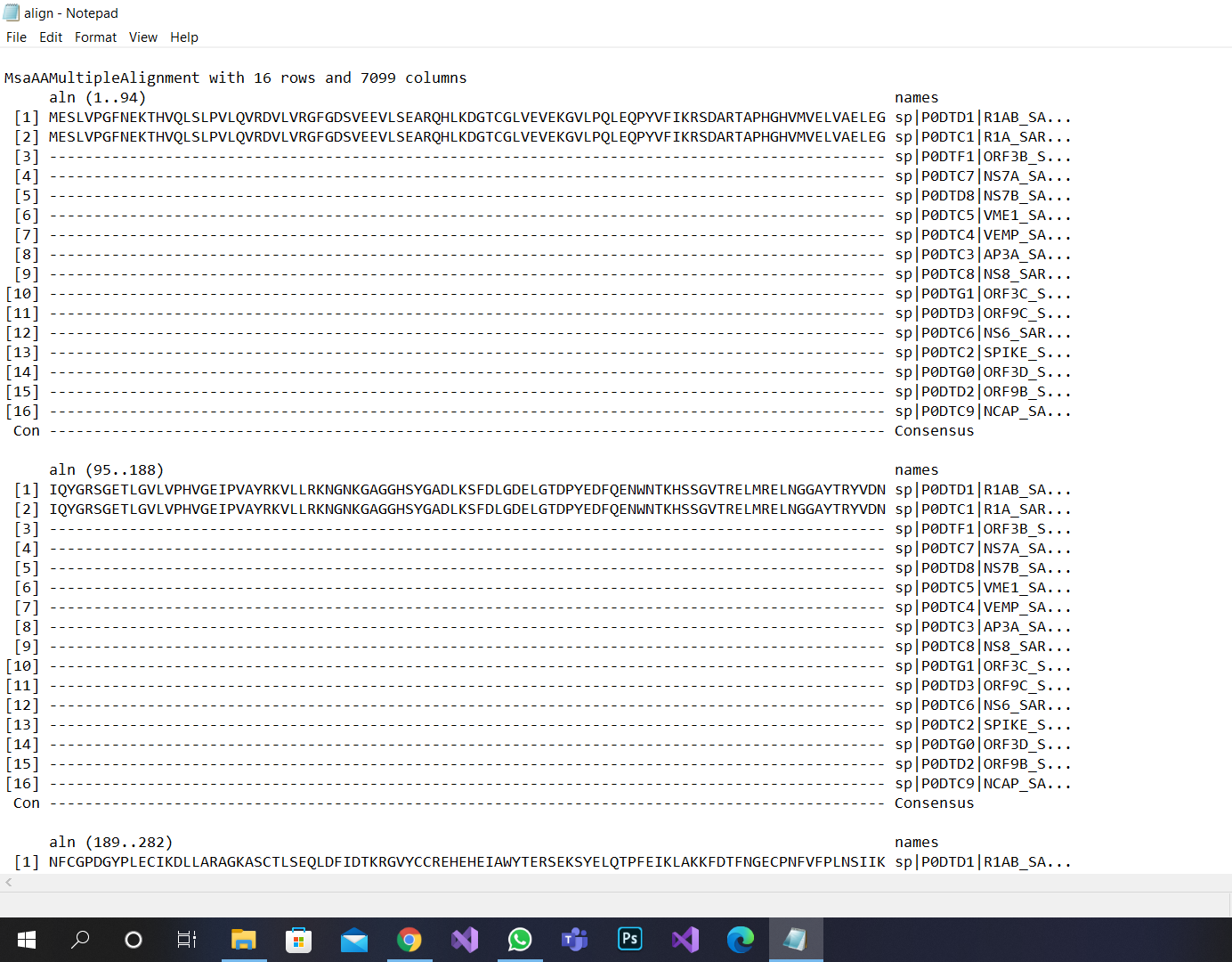
Align Multiple Proteins sequences

Slide 17
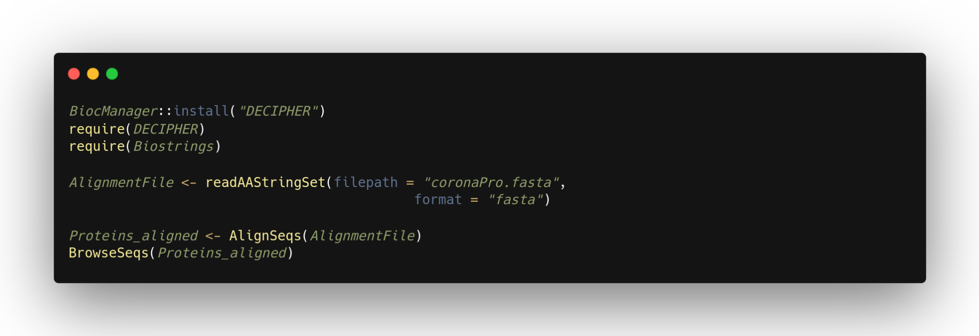
Visualise Multiple Proteins sequences

Slide 18
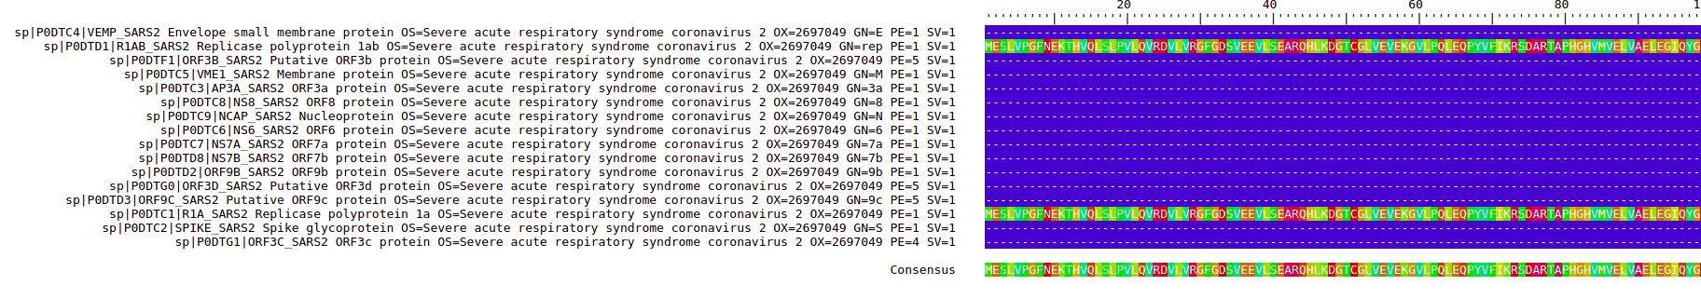
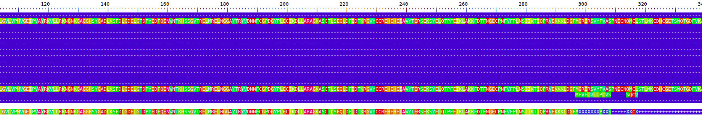
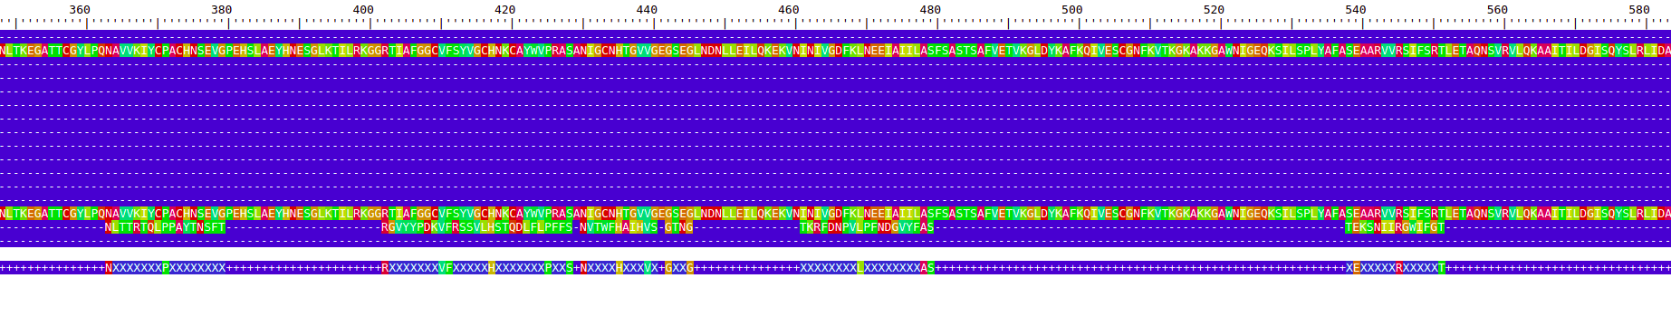

Slide 19
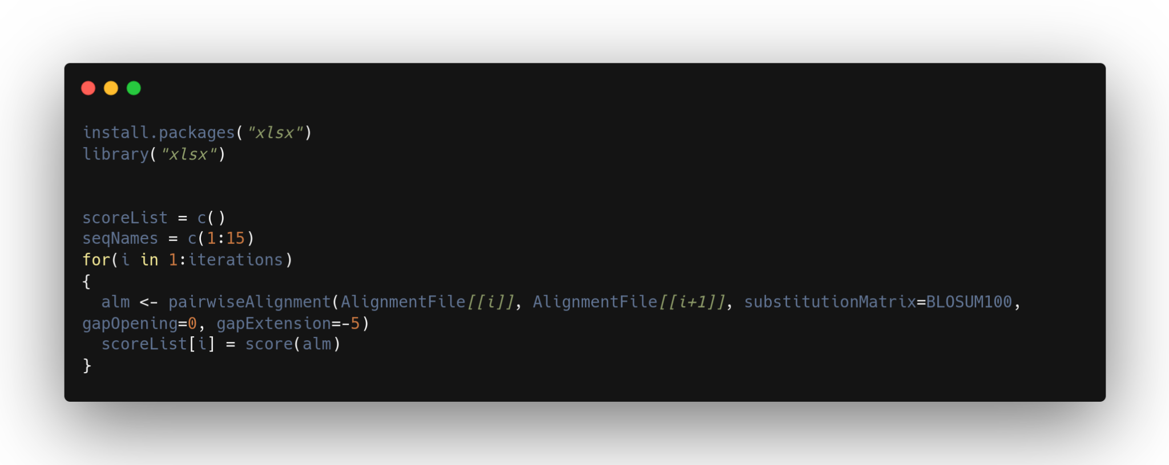
Score of every pairwise sequences

Slide 20
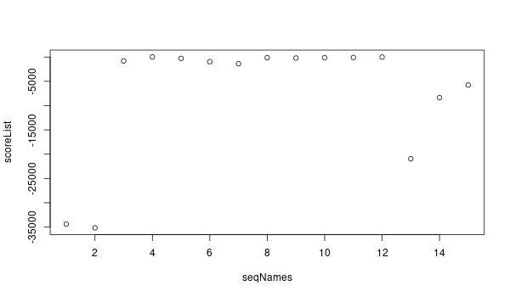
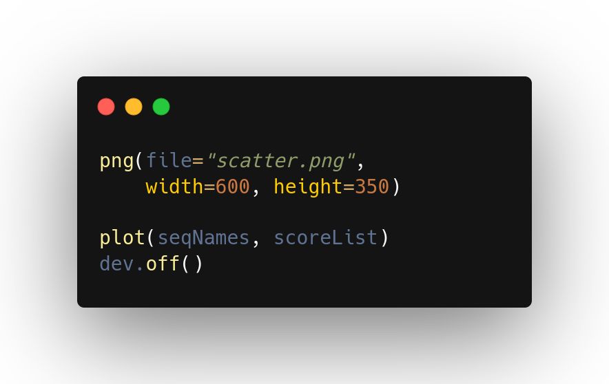
Visualise the result of sequence alignment with Scatter-plot

Slide 21
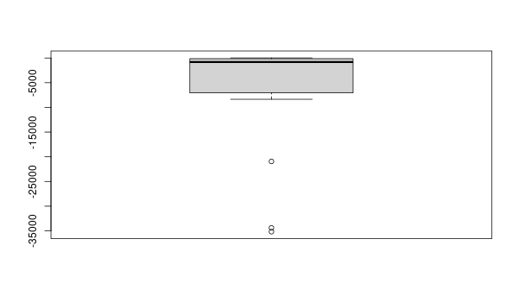
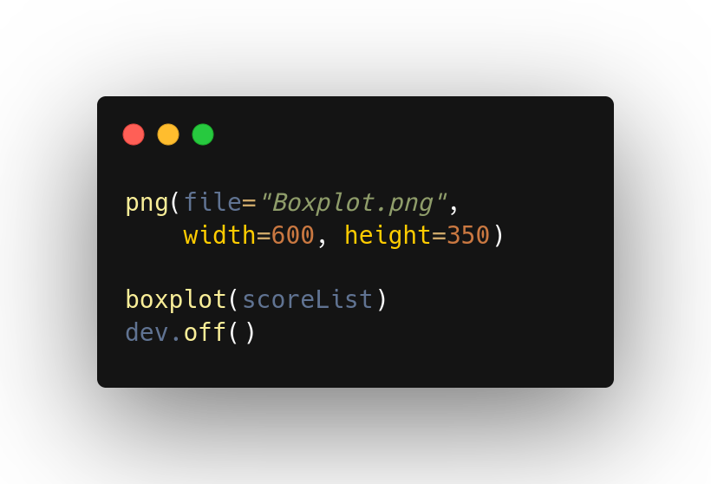
Visualise the result of sequence alignment with Box-plot

Slide 22
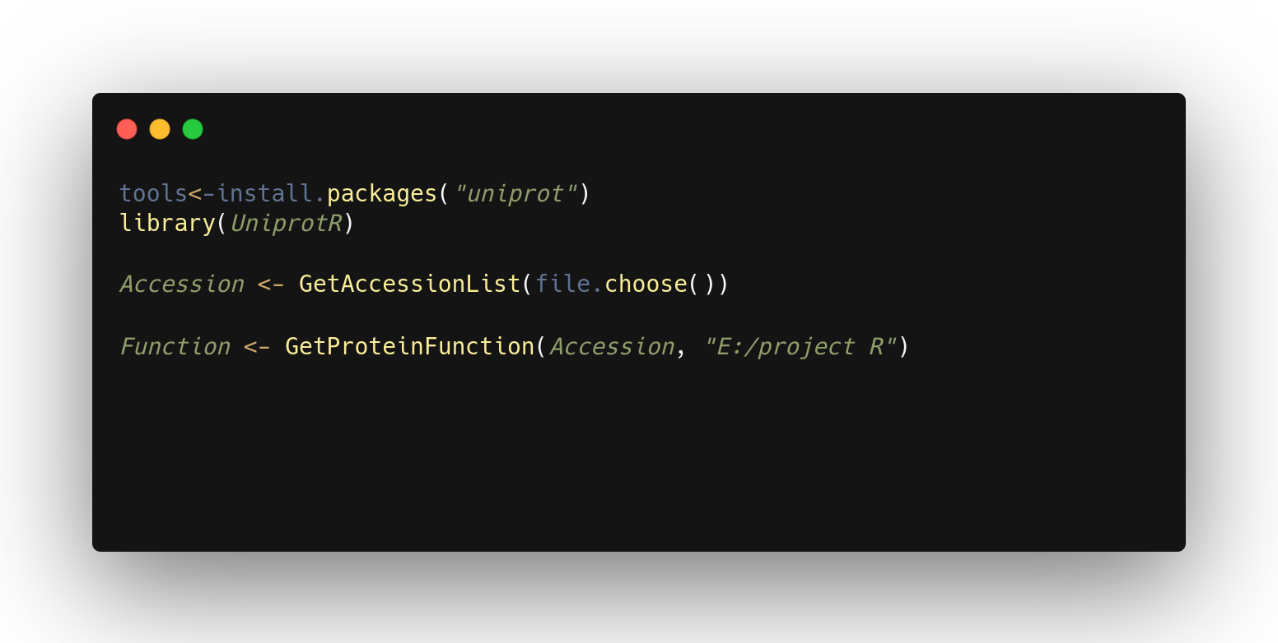
Similar functions for those high
protein sequence similarity

Slide 23
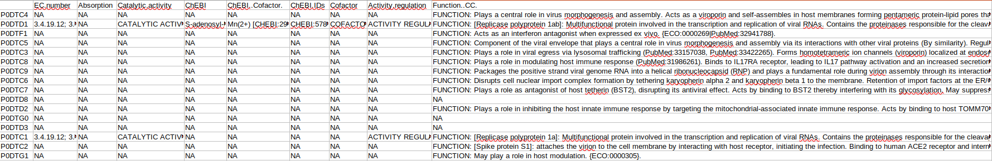
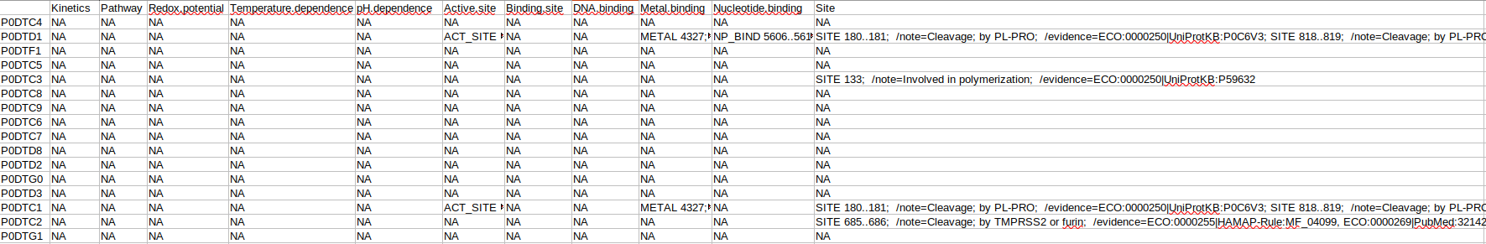
Similar functions for those high
protein sequence similarity

Slide 24
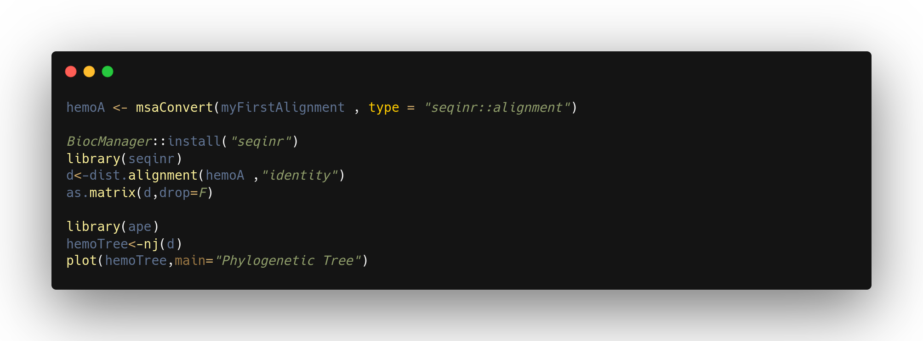
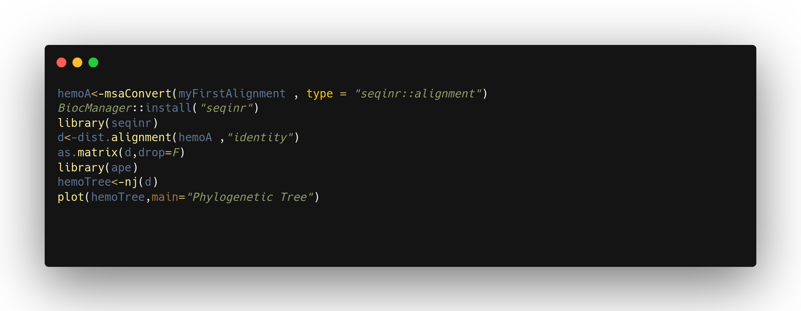
Constructing a Phylogenetic Tree

Slide 25
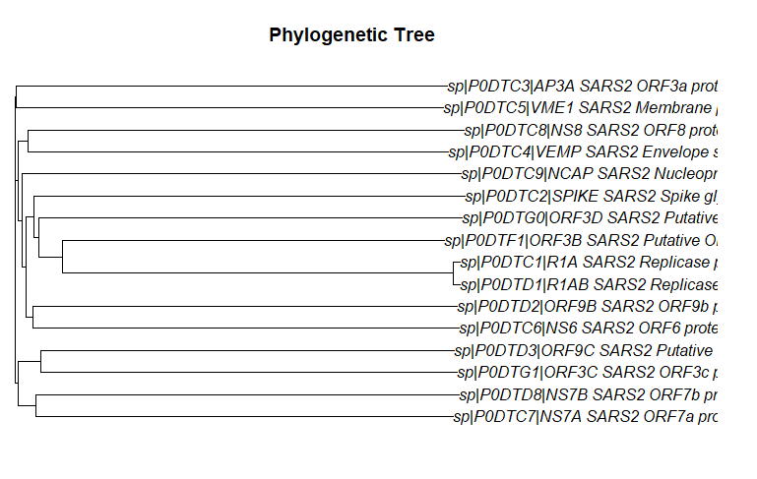

Slide 26
Thanks for watching

